Slide 1
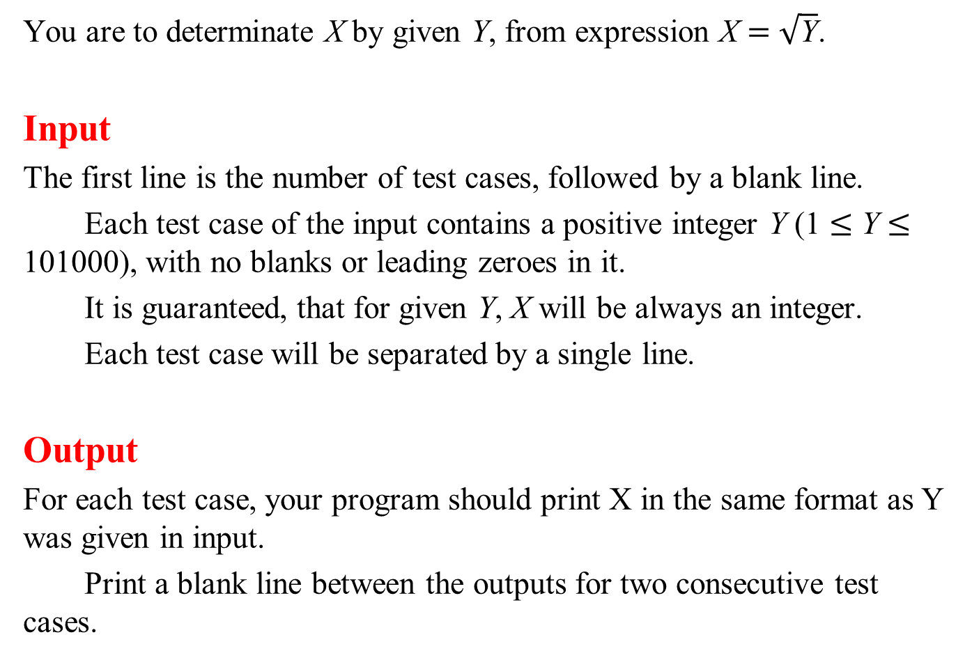
You are to determinate X by given Y, from expression X = $\sqrt{\text{Y}}$.
Input
The first line is the number of test cases, followed by a blank line.
Each test case of the input contains a positive integer Y (1 ≤ Y ≤ 101000), with no blanks or leading zeroes in it.
It is guaranteed, that for given Y, X will be always an integer.
Each test case will be separated by a single line.
Output
For each test case, your program should print X in the same format as Y was given in input.
Print a blank line between the outputs for two consecutive test cases.

Slide 2
Sample Input
1
7206604678144
Sample Output
2684512

Slide 3
Square − 4 digits
 | 1 | 0
hugeInt | 268 | 4999
 | 3 | 2 | 1 | 0
square | 0 | 0 | 1339732 | 24990001

Slide 4
Square − 4 digits
 | 1 | 0
hugeInt | 268 | 4999
 | 3 | 2 | 1 | 0
square | 0 | 71824 | 2679464 | 24990001

Slide 5
Square − 4 digits
 | 1 | 0
hugeInt | 268 | 4999
 | 3 | 2 | 1 | 0
square | 0 | 71824 | 2681963 | 0001

Slide 6
Square − 4 digits
 | 1 | 0
hugeInt | 268 | 4999
 | 3 | 2 | 1 | 0
square | 0 | 72092 | 1963 | 0001

Slide 7
Square − 4 digits
 | 1 | 0
hugeInt | 268 | 4999
 | 3 | 2 | 1 | 0
square | 7 | 2092 | 1963 | 0001

Slide 9
Square − 3 digits
 | 2 | 1 | 0
hugeInt | 2 | 684 | 999
 | 5 | 4 | 3 | 2 | 1 | 0
square | 0 | 0 | 0 | 1998 | 683316 | 998001

Slide 10
Square − 3 digits
 | 2 | 1 | 0
hugeInt | 2 | 684 | 999
 | 5 | 4 | 3 | 2 | 1 | 0
square | 0 | 0 | 1368 | 469854 | 1366632 | 998001

Slide 11
Square − 3 digits
 | 2 | 1 | 0
hugeInt | 2 | 684 | 999
 | 5 | 4 | 3 | 2 | 1 | 0
square | 0 | 4 | 2736 | 471852 | 1366632 | 998001

Slide 12
Square − 3 digits
 | 2 | 1 | 0
hugeInt | 2 | 684 | 999
 | 5 | 4 | 3 | 2 | 1 | 0
square | 0 | 4 | 2736 | 471852 | 1367630 | 001

Slide 13
Square − 3 digits
 | 2 | 1 | 0
hugeInt | 2 | 684 | 999
 | 5 | 4 | 3 | 2 | 1 | 0
square | 0 | 4 | 2736 | 473219 | 630 | 001

Slide 14
Square − 3 digits
 | 2 | 1 | 0
hugeInt | 2 | 684 | 999
 | 5 | 4 | 3 | 2 | 1 | 0
square | 0 | 4 | 3209 | 219 | 630 | 001

Slide 15
Square − 3 digits
 | 2 | 1 | 0
hugeInt | 2 | 684 | 999
 | 5 | 4 | 3 | 2 | 1 | 0
square | 0 | 7 | 209 | 219 | 630 | 001

Slide 16
Square − 3 digits
 | 2 | 1 | 0
hugeInt | 2 | 684 | 999
 | 4 | 3 | 2 | 1 | 0
square | 7 | 209 | 219 | 630 | 001

Slide 18
Square − TLE
 | 1 | 0
hugeInt | 268 | 4999
 | 3 | 2 | 1 | 0
square | 0 | 0 | 1339732 | 24990001

Slide 19
Square − TLE
 | 1 | 0
hugeInt | 268 | 4999
 | 3 | 2 | 1 | 0
square | 0 | 0 | 1342231 | 00000001

Slide 20
Square − TLE
 | 1 | 0
hugeInt | 268 | 4999
 | 3 | 2 | 1 | 0
square | 0 | 134 | 2231 | 0001

Slide 21
Square − TLE
 | 1 | 0
hugeInt | 268 | 4999
 | 3 | 2 | 1 | 0
square | 0 | 71958 | 01341963 | 0001

Slide 22
Square − TLE
 | 1 | 0
hugeInt | 268 | 4999
 | 3 | 2 | 1 | 0
square | 0 | 72092 | 1963 | 0001

Slide 23
Square − TLE
 | 1 | 0
hugeInt | 268 | 4999
 | 3 | 2 | 1 | 0
square | 7 | 2092 | 1963 | 0001

Slide 25
Square Root
 | 3 | 2 | 1 | 0
hugeInt | 7 | 2066 | 0467 | 8144
 | 1 | 0
sqrt | 4999 | 0000
 | 3 | 2 | 1 | 0
square | 2499 | 0001 | 0000 | 0000

Slide 26
Square Root
 | 3 | 2 | 1 | 0
hugeInt | 7 | 2066 | 0467 | 8144
 | 1 | 0
sqrt | 2499 | 0000
 | 3 | 2 | 1 | 0
square | 2499 | 0001 | 0000 | 0000

Slide 27
Square Root
 | 3 | 2 | 1 | 0
hugeInt | 7 | 2066 | 0467 | 8144
 | 1 | 0
sqrt | 2499 | 0000
 | 3 | 2 | 1 | 0
square | 624 | 5001 | 0000 | 0000

Slide 28
Square Root
 | 3 | 2 | 1 | 0
hugeInt | 7 | 2066 | 0467 | 8144
 | 1 | 0
sqrt | 1249 | 0000
 | 3 | 2 | 1 | 0
square | 624 | 5001 | 0000 | 0000

Slide 29
Square Root
 | 3 | 2 | 1 | 0
hugeInt | 7 | 2066 | 0467 | 8144
 | 1 | 0
sqrt | 1249 | 0000
 | 3 | 2 | 1 | 0
square | 156 | 0001 | 0000 | 0000

Slide 30
Square Root
 | 3 | 2 | 1 | 0
hugeInt | 7 | 2066 | 0467 | 8144
 | 1 | 0
sqrt | 624 | 0000
 | 3 | 2 | 1 | 0
square | 156 | 0001 | 0000 | 0000

Slide 31
Square Root
 | 3 | 2 | 1 | 0
hugeInt | 7 | 2066 | 0467 | 8144
 | 1 | 0
sqrt | 624 | 0000
 | 3 | 2 | 1 | 0
square | 38 | 9376 | 0000 | 0000

Slide 32
Square Root
 | 3 | 2 | 1 | 0
hugeInt | 7 | 2066 | 0467 | 8144
 | 1 | 0
sqrt | 311 | 0000
 | 3 | 2 | 1 | 0
square | 38 | 9376 | 0000 | 0000

Slide 33
Square Root
 | 3 | 2 | 1 | 0
hugeInt | 7 | 2066 | 0467 | 8144
 | 1 | 0
sqrt | 311 | 0000
 | 3 | 2 | 1 | 0
square | 9 | 6721 | 0000 | 0000

Slide 34
Square Root
 | 3 | 2 | 1 | 0
hugeInt | 7 | 2066 | 0467 | 8144
 | 1 | 0
sqrt | 155 | 0000
 | 3 | 2 | 1 | 0
square | 9 | 6721 | 0000 | 0000

Slide 35
Square Root
 | 3 | 2 | 1 | 0
hugeInt | 7 | 2066 | 0467 | 8144
 | 1 | 0
sqrt | 155 | 0000
 | 3 | 2 | 1 | 0
square | 2 | 4025 | 0000 | 0000

Slide 36
Square Root
 | 3 | 2 | 1 | 0
hugeInt | 7 | 2066 | 0467 | 8144
 | 1 | 0
sqrt | 233 | 0000
 | 3 | 2 | 1 | 0
square | 2 | 4025 | 0000 | 0000

Slide 37
Square Root
 | 3 | 2 | 1 | 0
hugeInt | 7 | 2066 | 0467 | 8144
 | 1 | 0
sqrt | 233 | 0000
 | 3 | 2 | 1 | 0
square | 5 | 4289 | 0000 | 0000

Slide 38
Square Root
 | 3 | 2 | 1 | 0
hugeInt | 7 | 2066 | 0467 | 8144
 | 1 | 0
sqrt | 272 | 0000
 | 3 | 2 | 1 | 0
square | 5 | 4289 | 0000 | 0000

Slide 39
Square Root
 | 3 | 2 | 1 | 0
hugeInt | 7 | 2066 | 0467 | 8144
 | 1 | 0
sqrt | 272 | 0000
 | 3 | 2 | 1 | 0
square | 7 | 3984 | 0000 | 0000

Slide 40
Square Root
 | 3 | 2 | 1 | 0
hugeInt | 7 | 2066 | 0467 | 8144
 | 1 | 0
sqrt | 252 | 0000
 | 3 | 2 | 1 | 0
square | 7 | 3984 | 0000 | 0000

Slide 41
Square Root
 | 3 | 2 | 1 | 0
hugeInt | 7 | 2066 | 0467 | 8144
 | 1 | 0
sqrt | 252 | 0000
 | 3 | 2 | 1 | 0
square | 6 | 3984 | 0000 | 0000

Slide 42
Square Root
 | 3 | 2 | 1 | 0
hugeInt | 7 | 2066 | 0467 | 8144
 | 1 | 0
sqrt | 252 | 0000
 | 3 | 2 | 1 | 0
square | 6 | 3504 | 0000 | 0000

Slide 43
Square Root
 | 3 | 2 | 1 | 0
hugeInt | 7 | 2066 | 0467 | 8144
 | 1 | 0
sqrt | 262 | 0000
 | 3 | 2 | 1 | 0
square | 6 | 3504 | 0000 | 0000

Slide 44
Square Root
 | 3 | 2 | 1 | 0
hugeInt | 7 | 2066 | 0467 | 8144
 | 1 | 0
sqrt | 262 | 0000
 | 3 | 2 | 1 | 0
square | 6 | 8644 | 0000 | 0000

Slide 45
Square Root
 | 3 | 2 | 1 | 0
hugeInt | 7 | 2066 | 0467 | 8144
 | 1 | 0
sqrt | 267 | 0000
 | 3 | 2 | 1 | 0
square | 6 | 8644 | 0000 | 0000

Slide 46
Square Root
 | 3 | 2 | 1 | 0
hugeInt | 7 | 2066 | 0467 | 8144
 | 1 | 0
sqrt | 267 | 0000
 | 3 | 2 | 1 | 0
square | 7 | 1289 | 0000 | 0000

Slide 47
Square Root
 | 3 | 2 | 1 | 0
hugeInt | 7 | 2066 | 0467 | 8144
 | 1 | 0
sqrt | 269 | 0000
 | 3 | 2 | 1 | 0
square | 7 | 1289 | 0000 | 0000

Slide 48
Square Root
 | 3 | 2 | 1 | 0
hugeInt | 7 | 2066 | 0467 | 8144
 | 1 | 0
sqrt | 269 | 0000
 | 3 | 2 | 1 | 0
square | 7 | 2361 | 0000 | 0000

Slide 49
Square Root
 | 3 | 2 | 1 | 0
hugeInt | 7 | 2066 | 0467 | 8144
 | 1 | 0
sqrt | 268 | 0000
 | 3 | 2 | 1 | 0
square | 7 | 2361 | 0000 | 0000

Slide 50
Square Root
 | 3 | 2 | 1 | 0
hugeInt | 7 | 2066 | 0467 | 8144
 | 1 | 0
sqrt | 268 | 0000
 | 3 | 2 | 1 | 0
square | 7 | 1824 | 0000 | 0000

Slide 51
Square Root
 | 3 | 2 | 1 | 0
hugeInt | 7 | 2066 | 0467 | 8144
 | 1 | 0
sqrt | 268 | 4999
 | 3 | 2 | 1 | 0
square | 7 | 1824 | 0000 | 0000

Slide 52
Square Root
 | 3 | 2 | 1 | 0
hugeInt | 7 | 2066 | 0467 | 8144
 | 1 | 0
sqrt | 268 | 4999
 | 3 | 2 | 1 | 0
square | 7 | 2092 | 1963 | 0001

Slide 53
Square Root
 | 3 | 2 | 1 | 0
hugeInt | 7 | 2066 | 0467 | 8144
 | 1 | 0
sqrt | 268 | 2499
 | 3 | 2 | 1 | 0
square | 7 | 2092 | 1963 | 0001

Slide 54
Square Root
 | 3 | 2 | 1 | 0
hugeInt | 7 | 2066 | 0467 | 8144
 | 1 | 0
sqrt | 268 | 2499
 | 3 | 2 | 1 | 0
square | 7 | 1958 | 0088 | 5001

Slide 55
Square Root
 | 3 | 2 | 1 | 0
hugeInt | 7 | 2066 | 0467 | 8144
 | 1 | 0
sqrt | 268 | 4515
 | 3 | 2 | 1 | 0
square | 7 | 1958 | 0088 | 5001

Slide 56
Square Root
 | 3 | 2 | 1 | 0
hugeInt | 7 | 2066 | 0467 | 8144
 | 1 | 0
sqrt | 268 | 4515
 | 3 | 2 | 1 | 0
square | 7 | 2066 | 2078 | 5225

Slide 57
Square Root
 | 3 | 2 | 1 | 0
hugeInt | 7 | 2066 | 0467 | 8144
 | 1 | 0
sqrt | 268 | 4512
 | 3 | 2 | 1 | 0
square | 7 | 2066 | 2078 | 5225

Slide 58
Square Root
 | 3 | 2 | 1 | 0
hugeInt | 7 | 2066 | 0467 | 8144
 | 1 | 0
sqrt | 268 | 4512
 | 3 | 2 | 1 | 0
square | 7 | 2066 | 0467 | 8144

